Slide 1


Conhecendo AWS Serverless com CDK, Java e Python
#ptBr
#JoinCommunity2023

Slide 2
Getting to know AWS Serverless with CDK, Java and Python
#en-US
#JoinCommunity2023

Slide 3

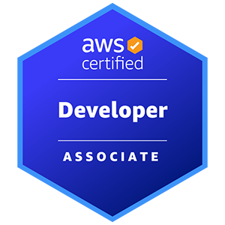
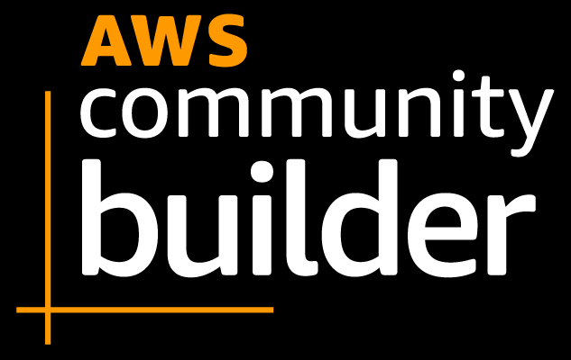




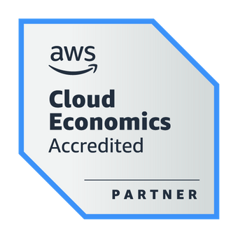
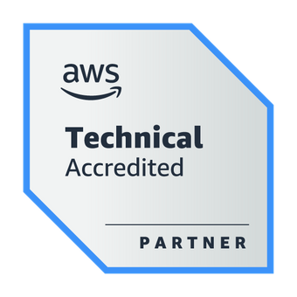
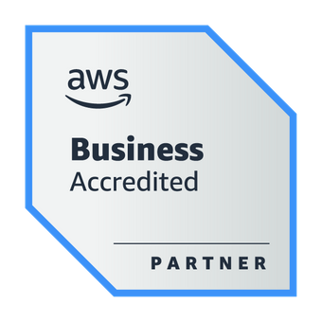

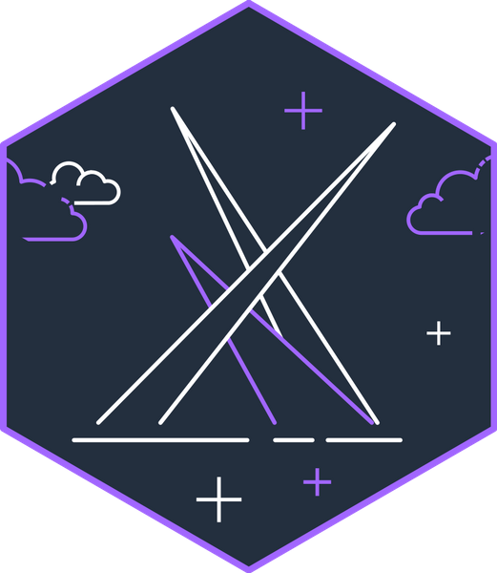
About the Speaker
Weder Mariano de Sousa
Specialist Senior Java - GFT
Technician System Development
Graduated Computer Science
https://www.linkedin.com/in/wedermarianodesousa/
Post Graduate in Midias UFG
https://github.com/weder96
Post Graduate in Information Security
https://twitter.com/weder96
https://dev.to/weder96
GOJava
AWS User Group Goiânia

Slide 4

Agenda
Question AI
Install AWS Command Line Interface (AWS CLI) Linux
AWS IDE Toolkits
Prerequisites and Tools
Serverless
AWS Storage
AWS Database
AWS API Gateway
AWS Application Integration
AWS Application Orchestration
AWS Lambda Overview
Invoke Lambda Functions
Pattern: The comfortable “REST”
Architecture Serverless
AWS CDK For Java and Python
Next Steps

Slide 5



Question AI
Criar uma rotina de estudo focado na aprendizagem de Serverless AWS ?

Slide 6

ChatGPT
Lembre-se de que a prática é fundamental para o
aprendizado.
À medida que você avança na sua rotina de estudo,
trabalhe em projetos reais para consolidar seus
conhecimentos.
Serverless é uma abordagem poderosa, e dominá-la
pode abrir muitas oportunidades no mundo
da computação em nuvem.
Semana 1-2: Fundamentos da AWS
Semana 3-4: Conceitos Básicos de Serverless
Semana 5-6: Desenvolvimento Serverless
Semana 7-8: Arquitetura e Segurança Serverless
Semana 9-10: Monitoramento e Depuração
Semana 11-12: Serverless Avançado e Projetos
Além da Rotina de Estudo:
Participe de comunidades online relacionadas à AWS e Serverless
para fazer perguntas, compartilhar conhecimentos e aprender
com os outros.
Considere a certificação AWS Certified Developer - Associate
para validar suas habilidades Serverless.
Mantenha-se atualizado lendo blogs, assistindo a webinars e
participando de eventos relacionados à AWS e Serverless.
Nas últimas semanas, vá além dos conceitos básicos:
Serverless Framework: Familiarize-se com o Serverless
Framework para facilitar o desenvolvimento e implantação
de aplicações Serverless.
Projetos Práticos: Comece a criar projetos práticos para
aplicar seus conhecimentos e construir aplicações
Serverless reais.

Slide 7

Bard
Encontre um grupo de estudo. Trabalhar com outras pessoas
pode ajudá-lo a aprender e resolver problemas.
Não tenha medo de pedir ajuda. Se você ficar preso em um conceito,
não tenha medo de procurar ajuda do seu instrutor, de um amigo ou
de um grupo de discussão online.
Semana 1-2: Introdução a Serverless AWS
Semana 3-4: AWS Cognito, AWS CloudWatch AWS CloudFormation
Semana 5-6: Avanços em Serverless AWS Casos de uso de Serverless AWS Projetos de Serverless
Projetos pessoais: Construção de aplicações Serverless AWS
Recursos
Estudo autônomo: Leitura de documentação
Documentação da AWS Tutoriais da AWS
Esta rotina pode ser adaptada de acordo com as necessidades e
objetivos do aluno.
Por exemplo, alunos com experiência em desenvolvimento de
software podem avançar mais rapidamente no conteúdo.
Alunos com menos experiência podem dedicar mais tempo ao
estudo dos conceitos básicos.
Estabeleça metas realistas. Não tente aprender tudo de uma vez.
Comece com os conceitos básicos e avance gradualmente.
Crie um cronograma e cumpra-o. Ter um plano o ajudará a se
manter motivado e no caminho certo.

Slide 8

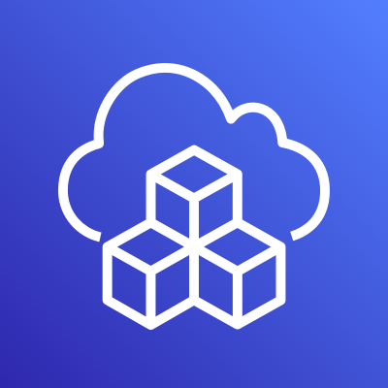
Prerequisites and Tools

Slide 9
Prerequisites and Tools
6 main Prerequisites;
AWS Account and User
AWS CLI
Python 3.10
IDE for your programming language = Visual Studio Code
IDE for your programming language = Intellij IDE
Postman

Slide 10
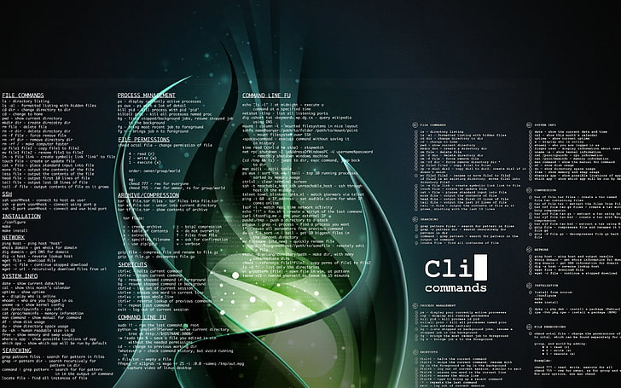

Install AWS Command Line Interface (AWS CLI) Linux

Slide 11
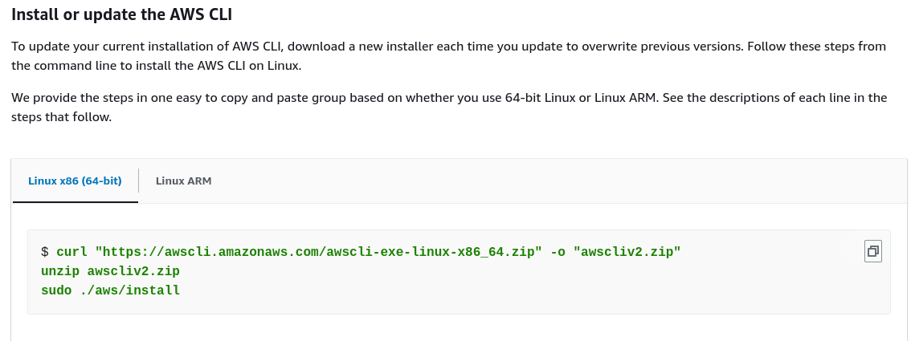
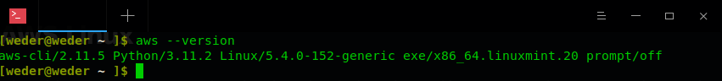
Install AWS Linux
You must be able to extract or "unzip" the downloaded package. if your operating system doesn't have the built-in unzip command, use an equivalent.
The AWS CLI uses glibc, groff, and less. These are included by default in most major distributions of Linux.
We support the AWS CLI on 64-bit versions of recent distributions of CentOS, Fedora, Ubuntu, Amazon Linux 1, Amazon Linux 2 and Linux ARM.
Because AWS doesn't maintain third-party repositories.
We can’t guarantee that they
contain the latest version of the AWS CLI.
https://docs.aws.amazon.com/cli/latest/userguide/getting-started-install.html

Slide 12



AWS IDE Toolkits

Slide 13
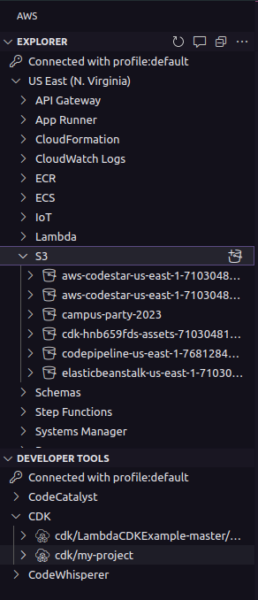
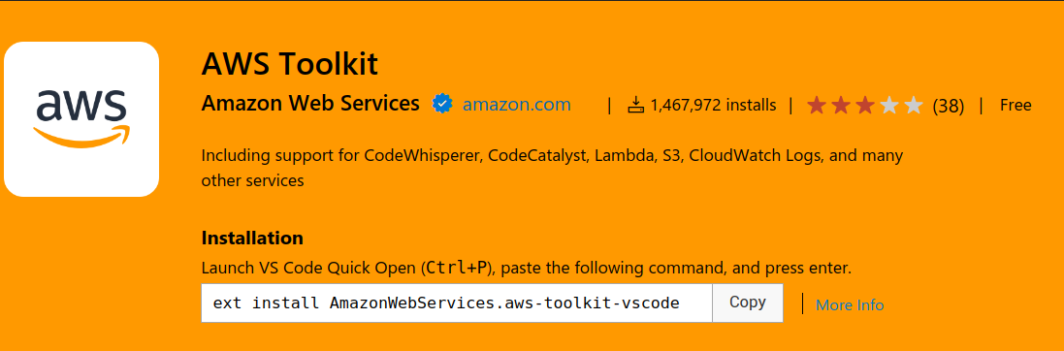
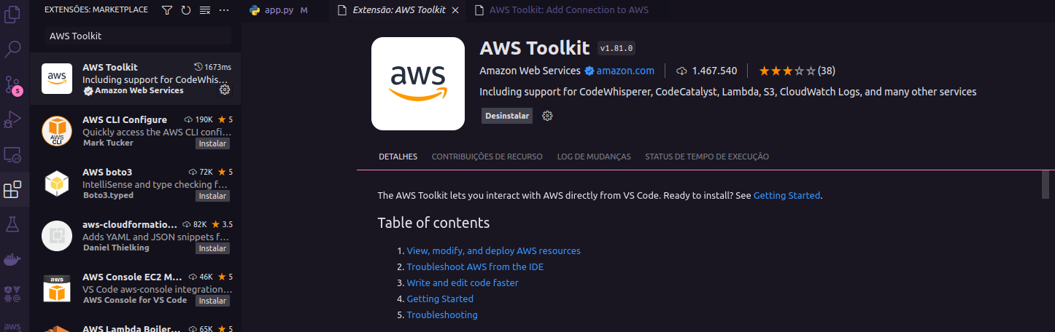
AWS Toolkit for Visual Studio Code
https://aws.amazon.com/serverless/?nc1=h_ls
https://marketplace.visualstudio.com/items?itemName=AmazonWebServices.aws-toolkit-vscode

Slide 14
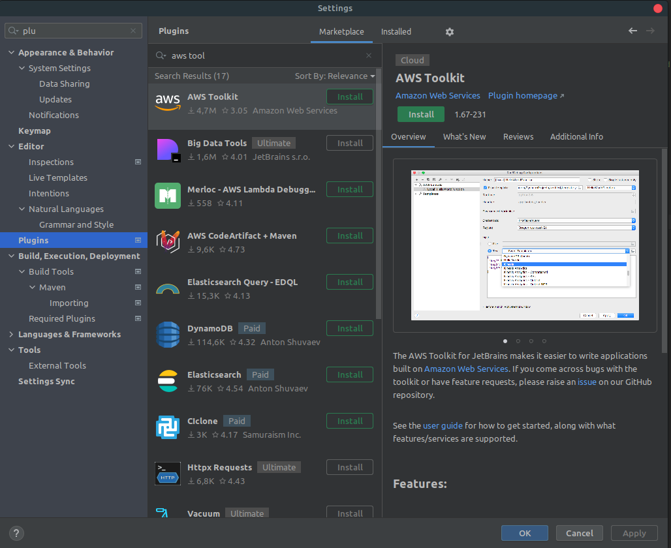

What is Toolkits de IDE da AWS ?

Slide 15
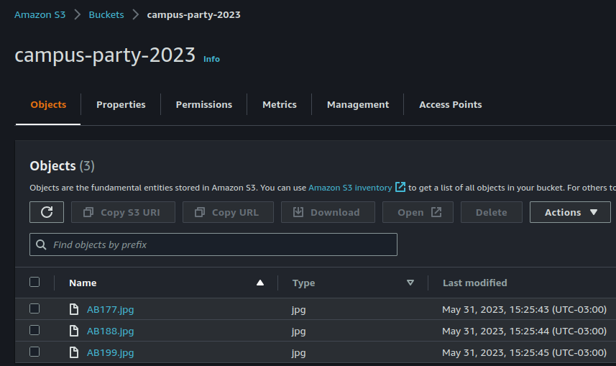
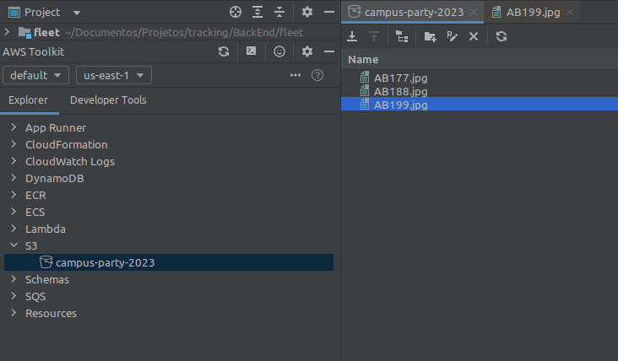
What is Toolkits de IDE da AWS ?

Slide 16


Serverless

Slide 17
What is Serverless ?
Serverless is a way to describe the services that enable you to build and run applications without thinking about servers. AWS has serverless services for all layers of your stack.
In many public forums, like our marketing website, we list these services under the Serverless heading because it improves discoverability.
When it comes to building an architecture diagram, it’s more intuitive to use a functional categorization. Please find the architecture icon for each serverless service in its functional category.
You can use the serverless category icon to describe serverless applications or architectures.
https://aws.amazon.com/serverless/?nc1=h_ls

Slide 18





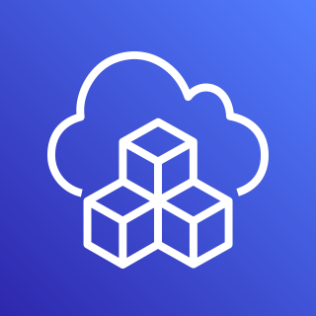




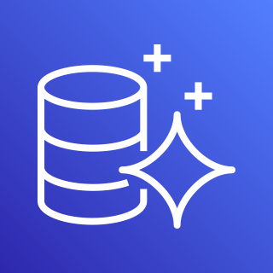
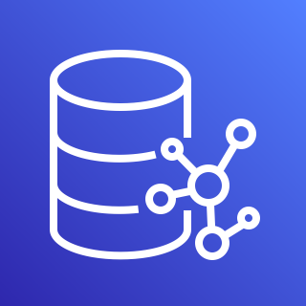
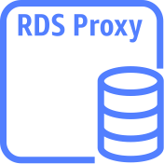






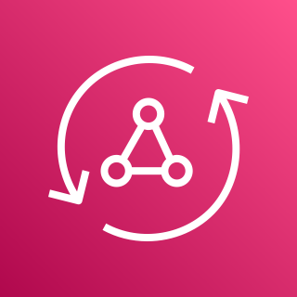

AWS Services Serverless
Compute
Authentication
and Authorization
Serverless Deployment
Frameworks
Application Integrations Services
AWS Lambda
AWS Fargate
Amazon Cognito
AWS CloudFormation
AWS CDK
Amazon
SNS
Amazon
SQS
Amazon
EventBridge
Data Persistence
Research and Analysis
Application Orchestration
DynamoDB
Aurora
Serverless
Neptune
Serverless
RDS
proxy instance
Amazon Redshift
OpenSearch
Service
AWS
Step Functions
Storing & Hosting
Streams
API and AppSync
Amazon S3
Amazon EFS
DynamoDB
Stream
Kinesis Data Streams
Amazon
API Gateway
AWS
AppSync
https://aws.amazon.com/serverless/?nc1=h_ls

Slide 19
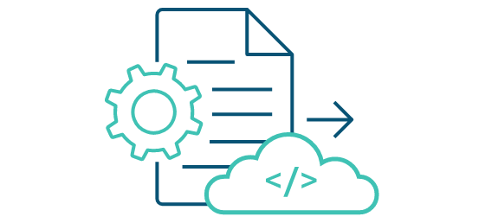


How to build, run and deploy?
When starting designing, and building serverless function, you might wonder how to deploy your function into the cloud. With AWS, there are some ways we can deploy, test and invoke your function:
Using the AWS Console Management: we can create lambda function, upload code, add triggers, and test your Lambda function manually. You might use this way when first.
AWS CLI: you also can use AWS Lambda CLI to create, deploy, invoke, manage, monitor your Lambda function. You can use existing commands to deploy and test your Lambda function automatically without manual process. But this isn’t good for production and large project.
AWS Serverless Application Model (AWS SAM) is an open-source framework for building serverless applications. It provides shorthand syntax to express functions, APIs, databases, and event source mappings.
AWS Cloud Development Kit (AWS CDK) is an open source software development framework to define your cloud application resources using familiar programming languages.
https://aws.amazon.com/serverless/getting-started/?nc=sn&loc=2&serverless.sort-by=item.additionalFields.createdDate&serverless.sort-order=desc

Slide 20
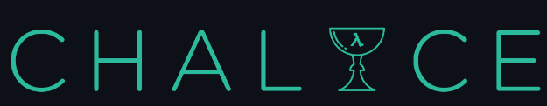

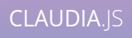
How to build, run and deploy?
Serverless Framework - The Serverless Framework consists of an open source CLI and a hosted dashboard. Together, they provide you with full serverless application lifecycle management.
Chalice is a framework for writing serverless apps in Python. It allows you to quickly create and deploy applications that use AWS Lambda.
Arc.codes provides everything you need to build massively scalable serverless apps with low code, clear and terse config, and zero ceremony.
Claudia.js makes it easy to deploy Node.js projects to AWS Lambda and API Gateway.
https://aws.amazon.com/serverless/getting-started/?nc=sn&loc=2&serverless.sort-by=item.additionalFields.createdDate&serverless.sort-order=desc

Slide 21
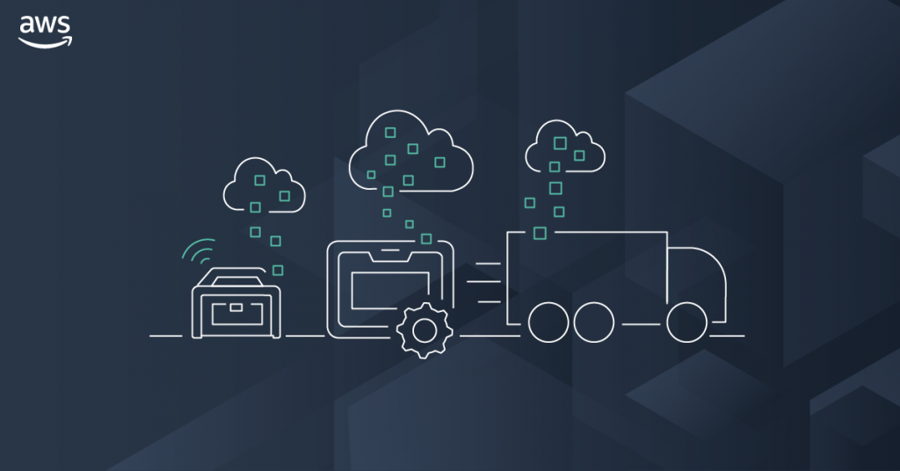
AWS Storage

Slide 22

What Is AWS S3?
Cloud storage is a web service where data can be stored, accessed, and quickly backed up by users on the internet. It is more reliable, scalable, and secure than traditional on-premises storage systems.
Amazon (Simple Storage Service) S3 stands for Amazon Simple Storage Service is a Object storage built to retrieve any amount of data from anywhere. Designed for durability.
Provides object storage, which is built for storing and recovering any amount of data from anywhere over the internet.
Enables users to store and retrieve any amount of data at any time or place, giving developers access to highly scalable, reliable, fast and inexpensive data storage.
Use Amazon S3 to store and protect any amount of data for a range of use cases, like data lakes, websites, mobile applications, backup and restore, archive, enterprise applications, IoT devices, and big data analytics.
Amazon S3
https://github.com/weder96/aws-certification-learning/tree/main/module-7

Slide 23
Amazon S3 Benefits and Features
Storage Classes; S3 offers a range of storage classes designed for different use cases. S3 Standard, S3 Standard-IA, S3 Galcier.
Storage Management; S3 has storage management features that we can use to manage costs, meet regulatory requirements, reduce latency.
Access Management; S3 provides features for auditing and managing access to buckets and objects.
Data Processing; To transform data and trigger workflows to automate a variety of other processing activities at scale.
Storage logging and monitoring; S3 provides logging and monitoring tools that you can use to monitor and control how your Amazon S3 resources are being used. S3 also offers features to gain visibility into your storage usage.
Strong Consistency; S3 provides strong read-after-write consistency for PUT and DELETE requests of objects in your Amazon S3 bucket in all AWS Regions.
Amazon S3
https://github.com/weder96/aws-certification-learning/tree/main/module-7

Slide 24
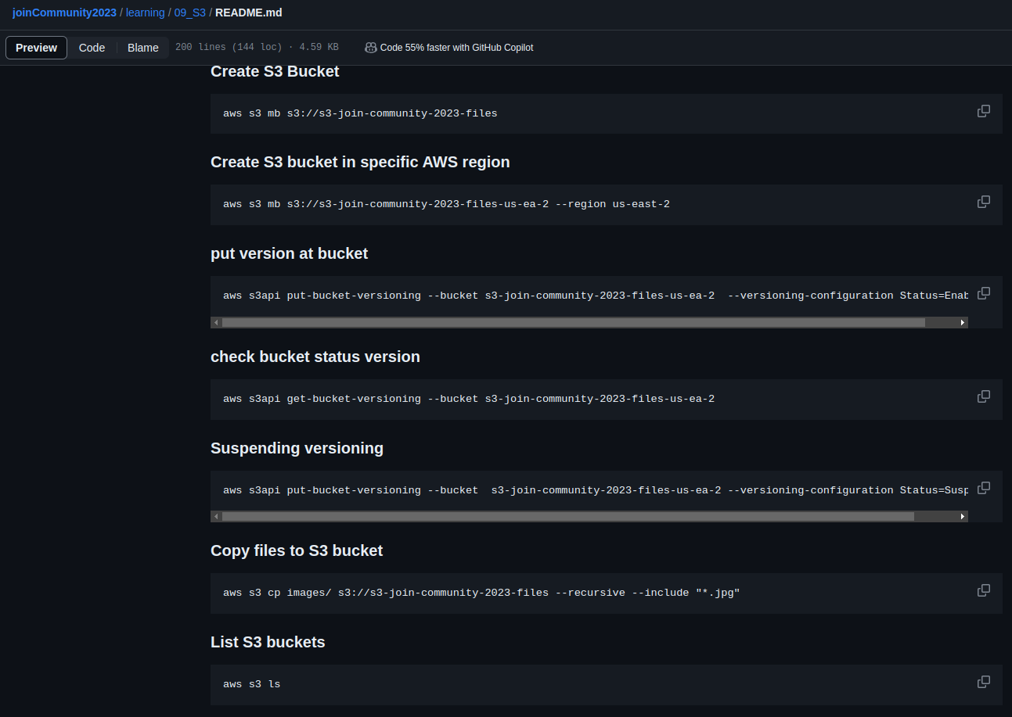

Amazon S3 CLI Commands
Amazon S3
https://github.com/weder96/joinCommunity2023/blob/main/learning/09_S3/README.md

Slide 25
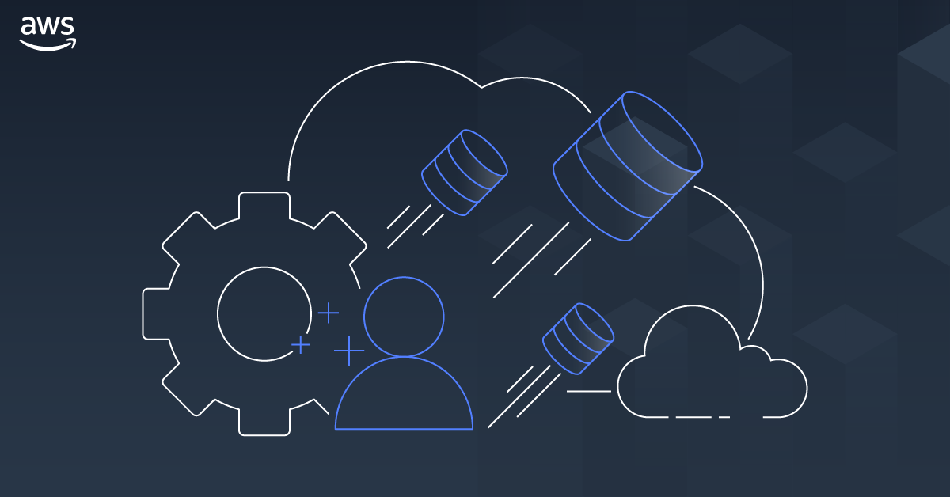
AWS Database

Slide 26

What Is Amazon DynamoDB?
Amazon DynamoDB is a fully managed NoSQL database service that provides fast and predictable performance with seamless scalability.
Serverless, key-value NoSQL database designed to run high-performance applications at any scale.
Create database tables that can store and retrieve any amount of data and serve any level of request traffic.
Scale up or down the throughput of your tables without downtime or performance degradation. DynamoDB provides on-demand backup capability.
High Availability and Durability
DynamoDB automatically spreads data and traffic for your tables across enough servers to meet your throughput.
https://github.com/weder96/aws-certification-learning/tree/main/module-8

Slide 27
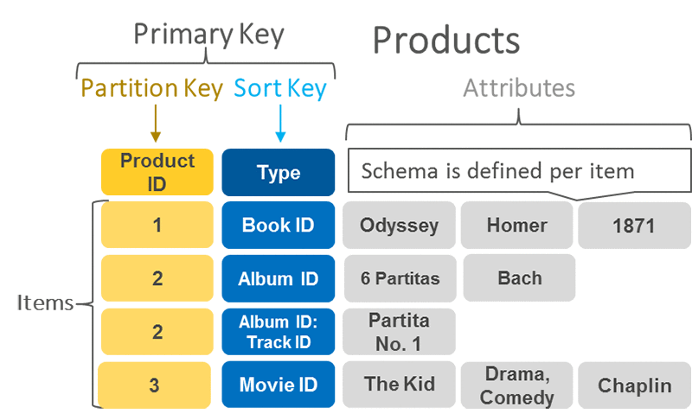
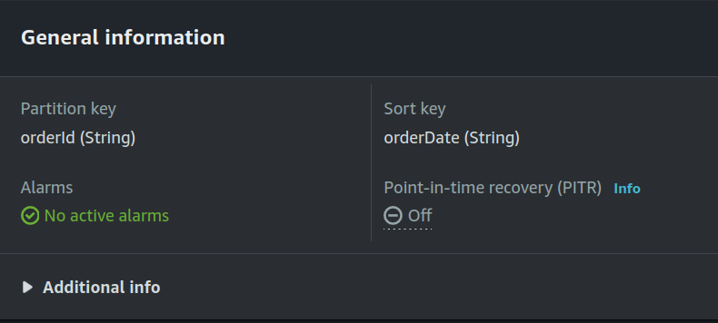
DynamoDB Primary Key, Partition Key and Sort Key
A primary key uniquely identifies each item in the table, so no
two items can have the same key. DynamoDB supports two
different kinds of primary keys:
Partition key
Partition key and sort key
Partition key
A simple primary key, composed of one attribute known as the
partition key.
Partition key and Sort Key
It is Referred to as a composite primary key, this type of key is
composed of two attributes. The first attribute is the partition
key, and the second attribute is the sort key.
DynamoDB uses the partition key value as input to an internal
hash function. A composite primary key gives you additional
flexibility when querying data
https://aws.amazon.com/blogs/database/choosing-the-right-dynamodb-partition-key/

Slide 28
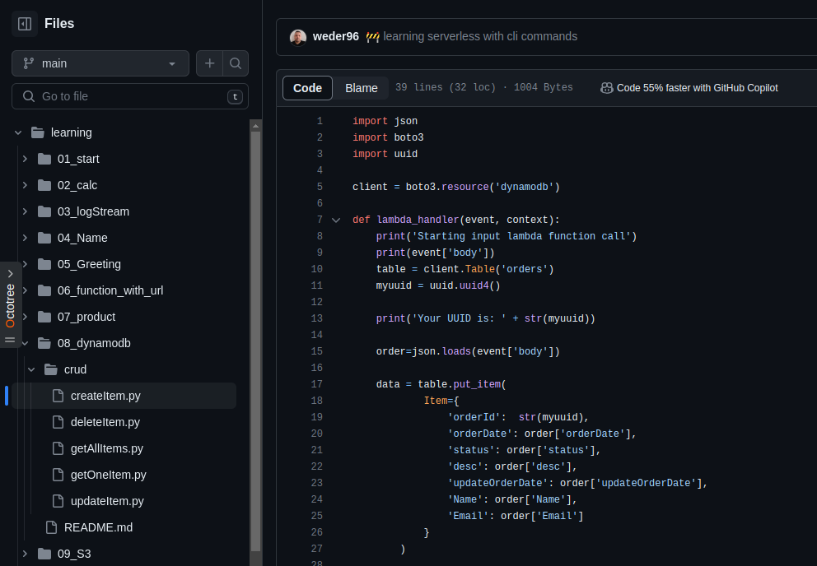

DynamoDB Python(Boto3)
https://github.com/weder96/joinCommunity2023/tree/main/learning/08_dynamodb

Slide 29
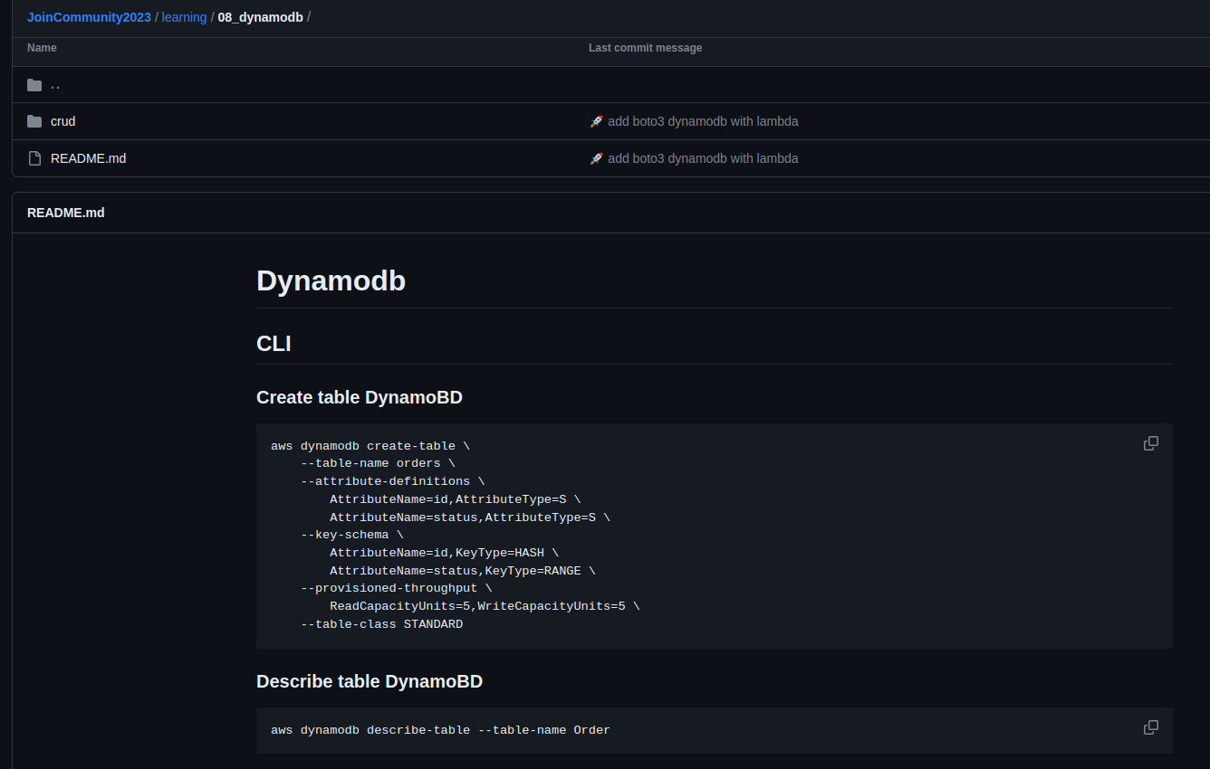
DynamoDB CLI Commands
https://github.com/weder96/joinCommunity2023/tree/main/learning/08_dynamodb

Slide 30
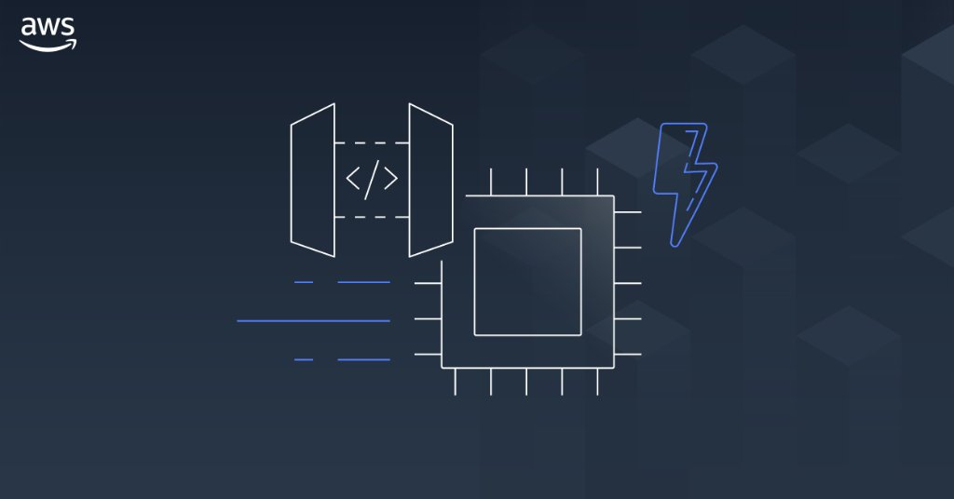
AWS API Gateway

Slide 31

What Is Amazon API Gateway ?
Enables developers to create, publish, maintain, monitor, and secure APIs at any scale.
This is a HIPAA eligible service.
Allows creating, deploying, and managing a RESTful API to expose backend HTTP endpoints, Lambda functions, or other AWS services.
Together with Lambda, API Gateway forms the app-facing part of the AWS serverless infrastructure.
Amazon
API Gateway
https://github.com/weder96/aws-certification-learning/tree/main/module-5#section-10

Slide 32
Amazon API Gateway Concepts
API Deployment – a point-in-time snapshot of your API Gateway API resources and methods. To be available for clients to use, the deployment must be associated with one or more API stages.
API endpoints – host names APIs in API Gateway, which are deployed to a specific region and of the format: rest-api-id.execute-api.region.amazonaws.com
API key – An alphanumeric string that API Gateway uses to identify an app developer who uses your API.
API stage – A logical reference to a lifecycle state of your API. API stages are identified by API ID and stage name.
Model – Data schema specifying the data structure of a request or response payload.
Private API – An API that is exposed through interface VPC endpoints and isolated from the public internet
Private integration – An API Gateway integration type for a client to access resources inside a customer’s VPC through a private API endpoint without exposing the resources to the public internet.
Proxy integration – You can set up a proxy integration as an HTTP proxy integration type or a Lambda proxy integration type.
Usage plan – Provides selected API clients with access to one or more deployed APIs. You can use a usage plan to configure throttling and quota limits, which are enforced on individual client API keys.
Amazon
API Gateway
https://github.com/weder96/aws-certification-learning/tree/main/module-5#section-10

Slide 33
Amazon API Gateway Endpoint Types
Edge-optimized API endpoint: The default host name of an API Gateway API that is deployed to the specified region while using a CloudFront distribution to facilitate client access typically from across AWS regions. API requests are routed to the nearest CloudFront Point of Presence.
Regional API endpoint: The host name of an API that is deployed to the specified region and intended to serve clients, such as EC2 instances, in the same AWS region. API requests are targeted directly to the region-specific API Gateway without going through any CloudFront distribution.
Private API endpoint: Allows a client to securely access private API resources inside a VPC. Private APIs are isolated from the public Internet, and they can only be accessed using VPC endpoints for API Gateway that have been granted access.
Amazon
API Gateway
https://github.com/weder96/aws-certification-learning/tree/main/module-5#section-10

Slide 34
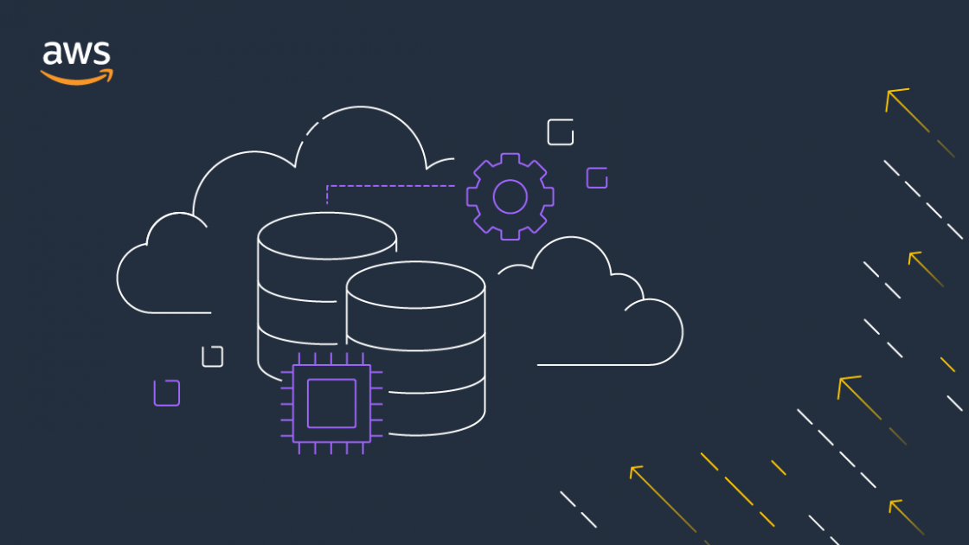

AWS Application Integration
SNS
SQS
EVENTBRIDGE

Slide 35
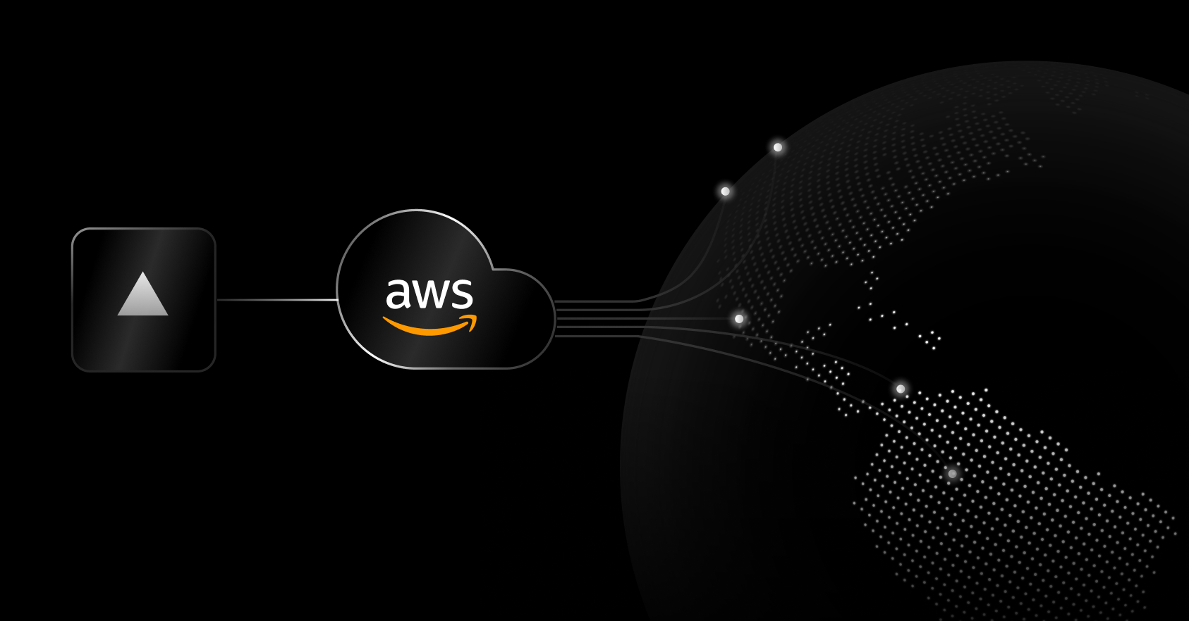
Amazon SNS

Slide 36




Amazon SNS: Fully Managed Pub/Sub Messaging
Application
Integration
Application integration
The Fanout scenario is when a message published to an SNS topic is replicated and pushed to multiple endpoints.
Application alerts
Amazon SNS can send notifications to specified users via SMS and email.
User notifications
Amazon SNS can send push email messages and text messages to individuals or groups.
Mobile push notifications
Mobile push notifications enable you to send
messages directly to mobile apps.
Amazon SNS
Amazon SQS
AWS Lambda
EventType=
Poll-based
Queue
Lambda Function
Messages
1,2,3,....
Topic
EventType=
Poll-based
Queue
Lambda Function

Slide 37
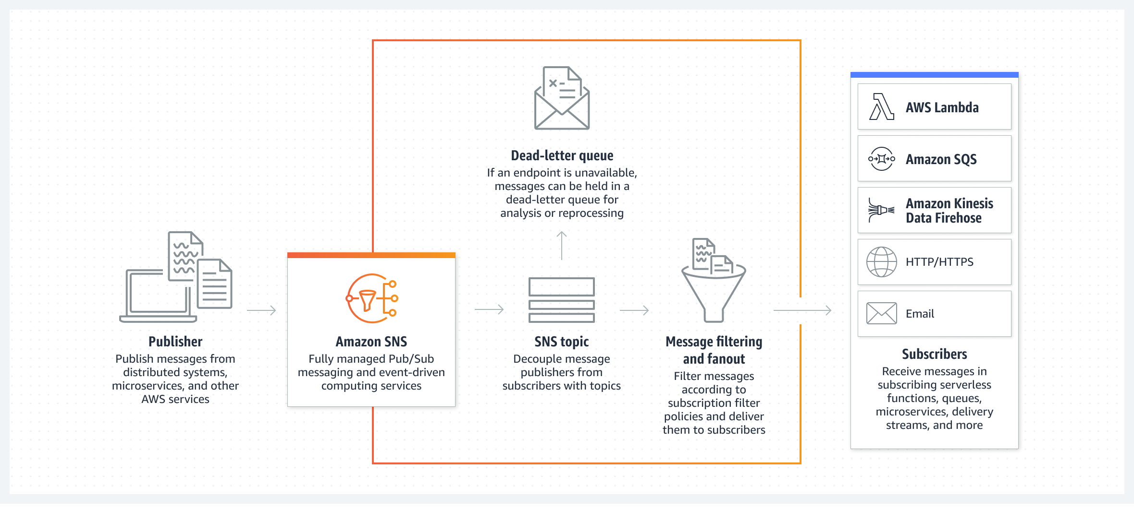
Amazon SNS: Fully Managed Pub/Sub Messaging
Application
Integration
Amazon SNS Actions
Create a topic
Delete a subscription
Delete a topic
List topics
Publish an SMS text message
Publish to a topic
Set a dead-letter queue for a subscription
Set a filter policy
Set the default settings for sending SMS messages
Set topic attributes
Subscribe a Lambda function to a topic
Subscribe a mobile application to a topic
Amazon SNS
https://aws.amazon.com/sns/?nc1=h_ls

Slide 38
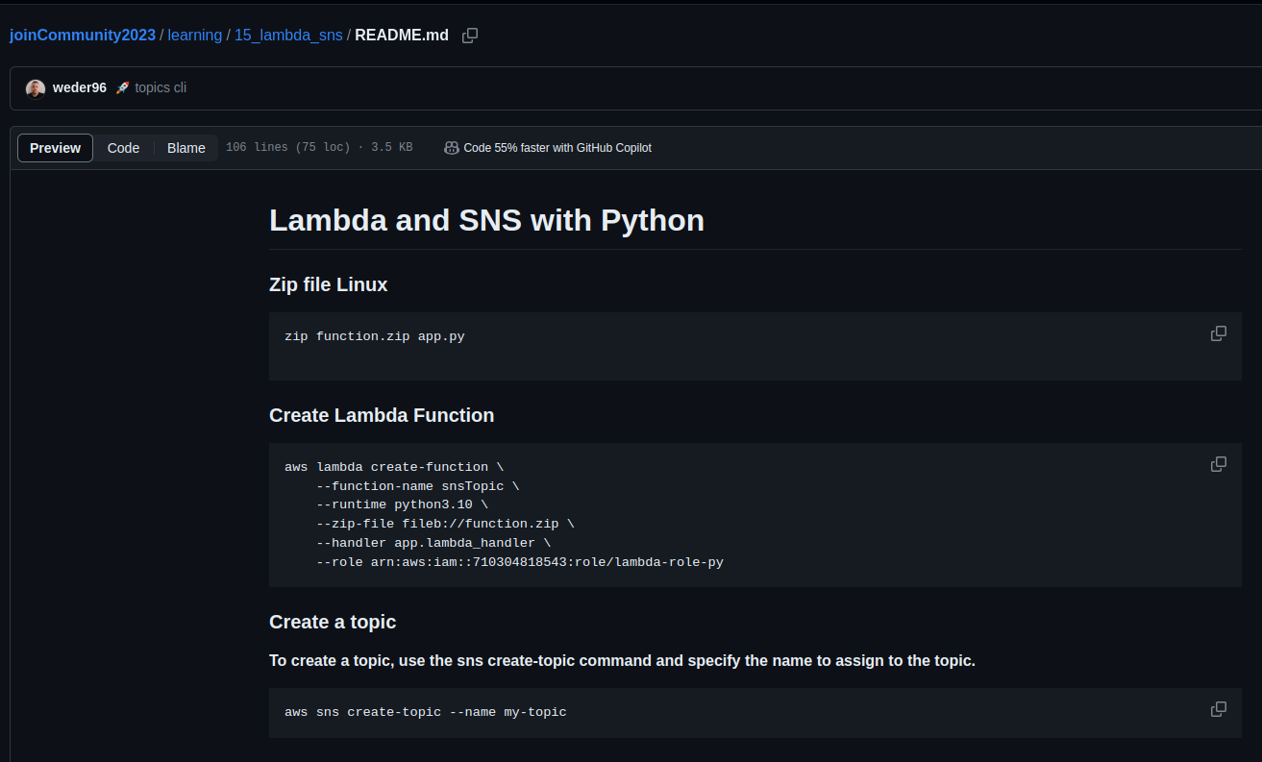

Amazon SNS CLI Commands and (Python) Boto3
Amazon SNS
https://github.com/weder96/joinCommunity2023/blob/main/learning/15_lambda_sns/README.md

Slide 39
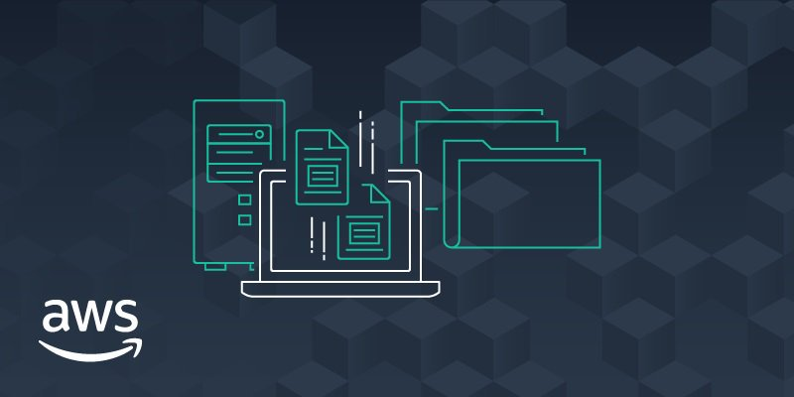
Amazon SQS

Slide 40
What is Amazon SQS ?
Application
Integration
Amazon SQS stands for Simple Queue Service is fully managed message queues for microservices,
distributed systems, and serverless applications.
Enables you to decouple and scale microservices, distributed systems, and serverless applications.
Eliminates the complexity and overhead associated with managing and operating message-oriented
middleware.
Send, store, and receive messages between software components at any volume.
Two types of message queues.
Standard queues offer maximum throughput, best-effort ordering, and at-least-once delivery.
FIFO queues are designed to guarantee that messages are processed exactly once, in the exact order that they are sent.
Integrate and decouple distributed software systems and components.
Provides a generic web services API that you can access using any programming language that the AWS
SDK supports.
Amazon SQS
https://aws.amazon.com/sns/?nc1=h_ls

Slide 41
Amazon SQS What’s a queue?
Application
Integration
Send MEssages
Pool messages
Producer
consumer
Producer
consumer
Queue
consumer
Producer
consumer
Amazon SQS
https://aws.amazon.com/sns/?nc1=h_ls

Slide 42
Benefits of Amazon SQS
Application
Integration
Eliminate administrative overhead
AWS manages all ongoing operations and underlying infrastructure needed to provide a highly available and
scalable message queuing service. SQS queues are dynamically created and scale automatically.
Durability and Reliability deliver messages
Amazon SQS stores them on multiple servers. Standard queues support at-least-once message delivery, and
FIFO queues support exactly-once message processing. SQS locks your messages during processing, so that
multiple producers can send and multiple consumers can receive messages at the same time.
Scalability and Availability and cost-effectively
SQS scales elastically with your application so you don’t have to worry about capacity planning and pre-
provisioning. There is no limit to the number of messages per queue, and standard queues provide nearly
unlimited throughput.
Security - Keep sensitive data secure
Amazon SQS to exchange sensitive data between applications using server-side encryption (SSE) to encrypt
each message body.
Amazon SQS
https://aws.amazon.com/sns/?nc1=h_ls

Slide 43
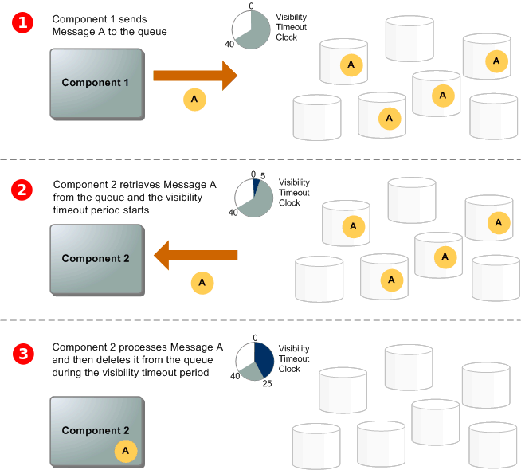
The lifecycle of an Amazon SQS message
Application
Integration
A producer (component 1) sends message A to a queue,
and the message is distributed across the Amazon SQS
servers redundantly.
When a consumer (component 2) is ready to process
messages, it consumes messages from the queue, and
message A is returned. While message A is being processed,
it remains in the queue and isn't returned to subsequent
receive requests for the duration of the
visibility timeout.
The consumer (component 2) deletes message A from
the queue to prevent the message from being received
and processed again when the visibility timeout expires.
Amazon SQS
https://docs.aws.amazon.com/AWSSimpleQueueService/latest/SQSDeveloperGuide/sqs-basic-architecture.html

Slide 44
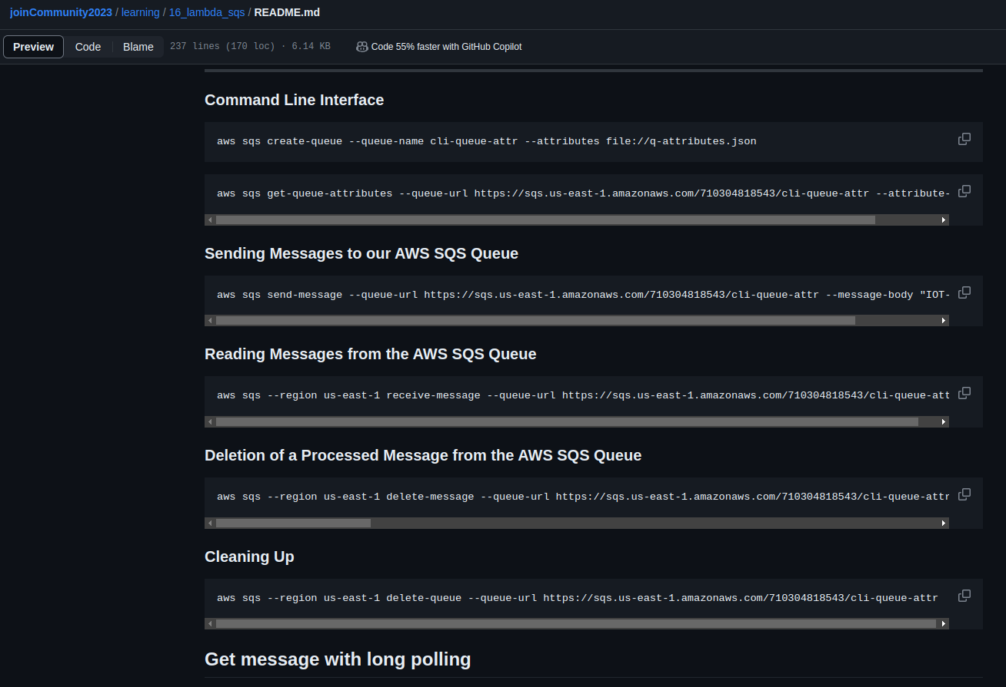

Amazon SQS CLI Commands and (Python) Boto3
Application
Integration
Amazon SQS
https://github.com/weder96/joinCommunity2023/blob/main/learning/16_lambda_sqs/README.md

Slide 45
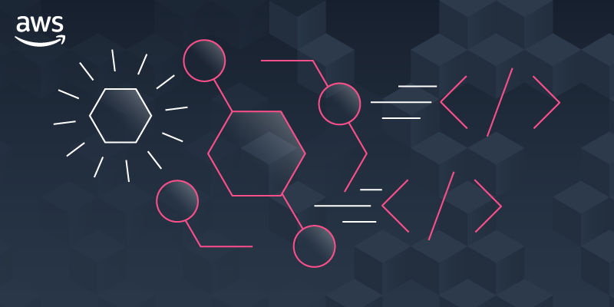
Amazon EventBridge

Slide 46
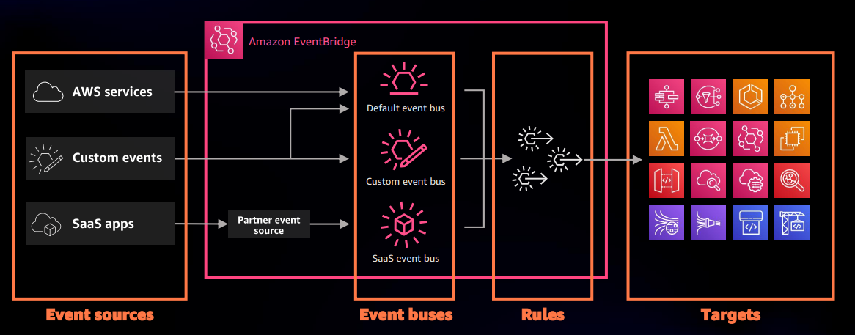
What is Amazon EventBridge ?
Serverless event bus service for AWS services
Build event-driven applications at scale using events generated from your apps
Use to connect your applications with data from a variety of sources, integrated SaaS applications
AWS services to targets such as AWS Lambda functions
Formerly called Amazon CloudWatch Events
https://serverlessland.com/patterns
https://da-public-assets.s3.amazonaws.com/serverlessland/pdf/2021+-+Serverlesspresso+exhibit+-+PDF.pdf

Slide 47
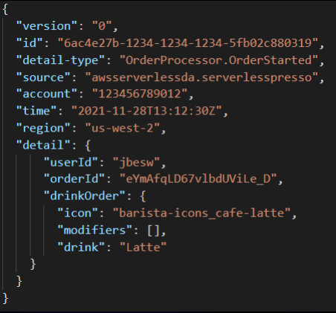
What are events?
An event is defined in JSON
"Detail" is application specific
Envelope attributes are provided by
Amazon EventBridge
Producers create events
Consumers choose which events to
Listen to by using rules
https://da-public-assets.s3.amazonaws.com/serverlessland/pdf/2021+-+Serverlesspresso+exhibit+-+PDF.pdf

Slide 48
Benefits of Amazon EventBridge
Build event-driven architectures
With EventBridge, your event targets don’t need to be aware of event sources because you can filter and
publish directly to EventBridge. Improves developer agility as well as application resiliency with loosely coupled
event-driven architectures.
Connect SaaS apps
EventBridge ingests data from supported SaaS applications and routes it to AWS services and SaaS targets.
SaaS apps to trigger workflows for customer support, business operations.
Write less custom code
You can ingest, filter, transform and deliver events without writing custom code.
The EventBridge schema registry stores a collection of easy-to-find event schemas.
Reduce operational overhead
There are no servers to provision, patch, and manage. automatically scales based on the number of events
ingested. Built-in distributed availability and fault-tolerance.
Native event archive and replay capability.

Slide 49


What are events?
Object Created
S3 Bucket
Eventbus
Eventbus
Order Created
Lambda
Custom Event
Events are the heart of any event-driven application
Producers raise events consumers consume then
Some AWS Services send events to EventBridge for consumption
or you can raise you awn custom events
Serverless Visuals: Small bite sized visuals about Amazon EventBridge David Boyne

Slide 50
EventBridge Concepts - Events - Event Buses - Rules - Targets
Amazon EventBridge Events
An event indicates a change in an environment such as an AWS environment or a SaaS partner service.
Events are represented as JSON objects and they all have a similar structure, and the same top-level fields.
Amazon EventBridge Rules
A rule matches incoming events and sends them to targets for processing. A single rule can send an event to
multiple targets, which then run in parallel.
An event pattern defines the event structure and the fields that a rule matches.
Amazon EventBridge Targets
A target is a resource or endpoint that EventBridge sends an event to when the event matches the event
pattern defined for a rule. The rule processes the event data and sends the relevant information to the target.
Amazon EventBridge Event Buses
An event bus is a pipeline that receives events. Rules associated with the event bus evaluate events as they
arrive.
A resource-based policy specifies which events to allow, and which entities have permission to create or
modify rules or targets for an event.
Amazon EventBridge

Slide 51
Understanding an EventBridge Bus
You can create own bus
send custom events to your bus
Does not know about
consumers decoupled
Connects Producer
with Consumers
Also knoe as
eventbridge target
Order Created
Producer
Eventbus
Eventbus
consumer
Lambda
Producer
Custom Event Bus
Listen to AWS Service events
in your default event bus
Events bus is a key Component
Tag changed
on resources
CLoudTrail
Eventbus
Service Events
Default Event Bus
Every AWS account
has a defeult eventbus
Default bus and Custom buses
Serverless Visuals: Small bite sized visuals about Amazon EventBridge David Boyne

Slide 52

Understanding EventBridge target
Does not know about
consumers decoupled
Bus need permissions
to talk to targewt(ex lambda)
Eventbus
rule
target
filter out events
Eventbus
rule
Also knoe as
consumer
Target Example
Lambda
What are target ?
Targets are consumer of you events
use rules to process events before reaching targets
Target Permissions
Your eventBridge bus need permissions
to send events to targets
Serverless Visuals: Small bite sized visuals about Amazon EventBridge David Boyne

Slide 53
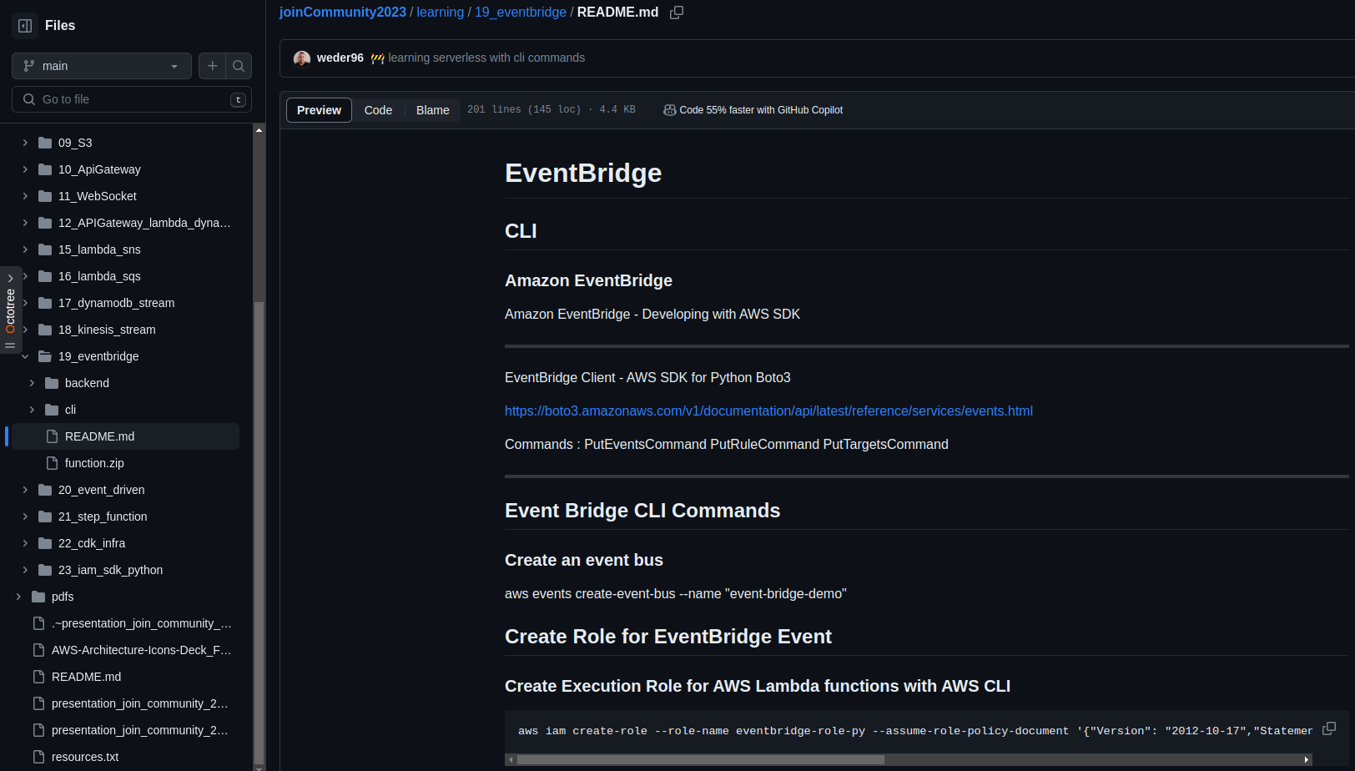

Amazon EventBridge CLI Commands and (Python) Boto3
Amazon EventBridge
https://github.com/weder96/joinCommunity2023/blob/main/learning/19_eventbridge/README.md

Slide 54

AWS Application Orchestration
STEP FUNCTIONS

Slide 55
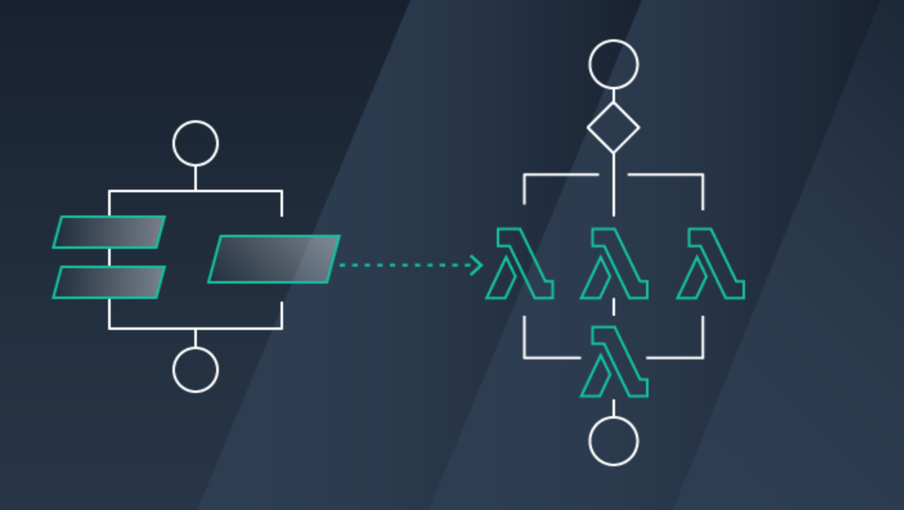
AWS Step Functions

Slide 56
What is AWS Step Functions ?
AWS Step Functions is a low-code, visual workflow service
that developers use to build distributed applications, automate
IT and business processes.
Step Functions is a serverless orchestration service that
combine AWS Lambda functions and other AWS services to
build business critical applications.
Step Functions is based on state machines and tasks. A state
machine is a workflow. A task is a state in a workflow that
represents a single unit of work that another AWS service
performs.
AWS Step Functions makes it easier to orchestrate multiple
AWS services to accomplish tasks.
Step Functions allows you to create steps in a process where
the output of one step becomes the input for another step, all
using a visual workflow editor.

Slide 57
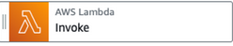




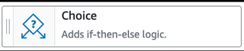
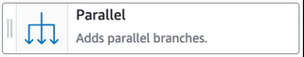
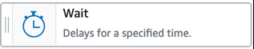

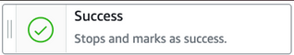
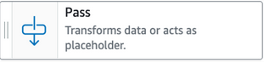

State types
Task
A single unit of work
Choice
Adds branching logic
Parallel
Fork and join the data across tasks
Wait
Delay for a specified time
Fail
Stops an execution and marks it as a failure
Succeed
Stops an execution successfully
Pass
Passes its input to its output
Map
Loop and Foreach

Slide 58
Benefits of using AWS Step Functions
Build and deploy rapidly
Get started quickly with Workflow Studio, a simple drag-and-drop interface. With Step Functions, you can
express complex business logic as low-code, event-driven workflows.
Write less integration code
Compose AWS resources from over 200 services including Lambda, ECS, Fargate, Batch, DynamoDB, SNS,
SQS, SageMaker, EventBridge.
Build fault-tolerant and stateful workflows
Built-in try/catch, retry, and rollback capabilities deal with errors and exceptions automatically based on your
defined business logic.
Designed for reliability and scale
Step Functions offers two workflow types - Standard or Express - that can be used depending on your specific
use case.
Decouple application workflow logic from business logic that is another best practice of Serverless
development.
AWS Step Functions

Slide 59
Drawbacks of using AWS Step Functions
▪ Complex Configuration
Configuration with the Amazon States Language Amazon States Language is quite complex. Its syntax hard to
read and modify.
▪ Over Engineering when using unnecessary cases
Decoupling business logic from task sequencing can make your code harder to understand While decoupling
services from the orchestration layer can make things more scalable and easier to operate.
▪ Vendor Lock-in
Vendor lock-in The Amazon States Language is proprietary and can only be used on AWS. Therefore, if you
decide to migrate to a different cloud provider, you’ll need to re-implement the orchestration layer.
AWS Step Functions

Slide 60


Create a Serverless Workflow with AWS Step Functions and AWS Lambda
https://aws.amazon.com/pt/tutorials/create-a-serverless-workflow-step-functions-lambda/

Slide 61


Amazon Step Functions CLI Commands and (Python) Boto3
AWS Step Functions
https://github.com/weder96/joinCommunity2023/blob/main/learning/21_step_function/README.md

Slide 62

AWS Lambda Overview

Slide 63
AWS Lambda Overview
Serverless on AWS, Build and run applications without thinking about servers
The most popular serverless compute platform that is using millions of customer
Running billions of invocations all over the world
Compute service that runs code without thinking any servers or underlying services
Serverless function that you only responsible for your actual code.
https://aws.amazon.com/serverless/?nc1=h_ls
https://aws.amazon.com/blogs/compute/serverless-icymi-q2-2023/

Slide 64


Serverless Explanained : AWS Operational Responsibility Model
https://d1.awsstatic.com/events/reinvent/2019/REPEAT_3_Serverless_architectural_patterns_and_best_practices_ARC307-R3.pdf

Slide 65


AWS Lambda Invocation Types
Triggered lambda functions with different AWS Lambda Invocation Types
AWS Lambda has 3 Invocation Types;
Lambda Synchronous invocation
Lambda Asynchronous invocation
Lambda Event Source Mapping with polling invocation
https://aws.amazon.com/blogs/architecture/understanding-the-different-ways-to-invoke-lambda-functions/

Slide 66

AWS Lambda Synchronous Invocation
Execute immediately when you perform the Lambda Invoke API call.
Wait for the function to process the function and return back to response.
API Gateway + Lambda + DynamoDB
Invocation-type flag should be “RequestResponse”
▪ Responsible for inspecting the response
and determining if there was an error
and decide to retry the invocation
▪ Example of synchronous invocation using the AWS CLI:
aws lambda invoke —function-name MyLambdaFunction —invocation-type RequestResponse —payload '{ "key": "value" }’
▪ Triggered AWS services of synchronous invocation; ELB (Application Load Balancer), Cognito,
Lex, Alexa, API Gateway, CloudFront, Kinesis Data Firehose
EventType =
RequestResponse
Users
Amazon API Gateway
AWS Lambda
Amazon DynamoDB

Slide 67
AWS Lambda Asynchronous Invocation
Lambda sends the event to a internal queue and returns a success response without
any additional information
Separate process reads events from the queue and runs our lambda function
S3 / SNS + Lambda + DynamoDB
Invocation-type flag should be “Event”
AWS Lambda sets a retry policy
Retry Count = 2
Attach a Dead-Letter Queue (DLQ)
Example of asynchronous invocation using the AWS CLI:
aws lambda invoke —function-name MyLambdaFunction —invocation-type Event —payload '{ "key": "value" }'
Triggered AWS services of asynchronous invocation; S3, EventBridge, SNS, SES,
CloudFormation, CloudWatch Logs, CloudWatch Events, CodeCommi
Amazon SNS
AWS Lambda
EventType =
Event
Users Write
Object
Amazon S3
AWS Lambda
Amazon DynamoDB
Amazon
EventBridge
AWS Lambda

Slide 68

AWS Lambda Event Source Mapping with Polling Invocation
Pool-Based invocation model allows us to integrate with AWS Stream and Queue based services.
Lambda will poll from the AWS SQS or Kinesis streams, retrieve records, and invoke functions.
Data stream or queue are read in batches,
The function receives multiple items when execute function.
Batch sizes can configure according to service types
SQS + Lambda
Stream based processing with DynamoDB Streams + Lambda
Triggered AWS services of Event Source Mapping invocation; Amazon Kinesis,
DynamoDB, Simple Queue Service (SQS)
EventType =
Poll-based
AWS SQS Queue
Stream
Add Item
into Queue
AWS Lambda
Amazon
DynamoDB

Slide 69

Lambda Function Code
AWS Lambda runs instances of your function to process
events.
Invoke function directly using the Lambda API, or
configure an AWS service or resource to invoke your function.
Lambda function has code to process the events
that you pass into the function or that other AWS
services send to the function with event json object.
The event object contains all the information about
the event that triggered this Lambda.
The context object contains info about the runtime
our Lambda function
Return the function with the results

Slide 70



Key concepts of Lambda Function Code
Runtime: select the runtime as part of configuring the function, and Lambda loads that runtime when initializing the environment.
Handler: function runs starting at the handler method.
Function: is a resource that you can invoke to run your code in Lambda.
Trigger: is a resource or configuration that invokes a
Lambda function.
Event: is a JSON-formatted document that contains data for a Lambda function to process.
Execution environment: provides a secure and isolated runtime environment for your Lambda function.
AWS Cloud
AWS Lambda Service
Event
Lambda
API
Function
code
API Gateway EndPoint
Lambda function
Bucket with objects
Lambda function
EventBridge Rule Scheduler
Lambda function

Slide 71
Key concepts of Lambda Function Code
Layer: can contain libraries, a custom runtime, data, or configuration files. Using layers reduces the size of uploaded deployment archives and makes it faster to deploy your code.
Concurrency: is the number of requests that your function is serving at any given time. When your function is invoked, Lambda provisions an instance of it to process the event. When the function code finishes running, it can handle another request.
Destination: is an AWS resource where Lambda can send events from an asynchronous invocation. configure a destination for events that fail processing like setting DLQ for Lambda fails.
AWS Cloud
AWS Lambda Service
Event
Lambda
API
Function
code
API Gateway EndPoint
Lambda function
Bucket with objects
Lambda function
EventBridge Rule Scheduler
Lambda function

Slide 72
Lambda Execution Environment Lifecycle
Init Phase
3 main tasks; Extension, Runtime and Funtion init. Ends when the runtime and all extensions are ready.
Limited to 10 seconds. If not complete, Lambda retries the Init phase.
Invoke Phase
Lambda invokes the function handler. Lambda prepares to handle another function invocation. Timeout setting
limits the duration of the entire Invoke phase. Next API request invokes another function.
Shutdown Phase
Happens if the Lambda function doesn't receive any invocations. Lambda shuts down the runtime, removes the environment. Lambda sends a Shutdown event to each extension.
Lifecycle Lambda Execution
Extension
Init
Runtime
Init
Function
Init
Invoke
Runtime
Shutdown
Extension
Shutdown
Invoke
Init
Invoke
Invoke
Shutdown
https://docs.aws.amazon.com/lambda/latest/dg/lambda-runtime-environment.html

Slide 73
Reducing Cold Start
SNAPSTART
Init during deployment
Create
Execution
Environment
Download
Code
Start
Runtime
Initialize
Function
Code
Pre
Snapshot
Hook
Create
Snapshot
(optional)
Resume
Invoke
Invoke
first request
Resume
Snapshot
Post
Snapshot
Hook
Code
execution
Code
execution
(optional)

Slide 74
Concurrency on AWS Lambda: Reserved and Provisioned
Memory and Timeout Configuration Optimization
The memory setting determines how much CPU power will receive for our lambda function. And higher CPU power decrease the function execution time.
When function reaches to timeout value and not finished, lambda forcibly stop the execution.
Concurrency: The number of instances of your function that are active.
Reserved Concurrency
Provisioned Concurrency
When your function is invoked, Lambda allocates an instance of it to process the incoming event.
If the function is invoked again when the request is still being processed, another instance is allocated, which increases the function's concurrency.

Slide 75



AWS Lambda Execution Role
Resource Based
Policy
Execute Role
Policy
AWS Lambda Permissions
Lambda Execution Role
Resource-based policy
Lambda Execution Role
IAM role that Lambda has permissions to assume when invoking
lambda function.
Create an execution role when creating a new lambda function, and
after that we can also modify the policies associated with the IAM role.
if you have additional targets from your lambda function
performing crud operations on DynamoDB table
sending notification to SNS
retrieve messages from queue or streams
Lambda function's execution role required permissions to
interact with those AWS services
Grant least privilege access to your Lambda execution role
Who can Invoke
Lambda ?
Who can interact
Lambda Invoke ?
AWS Lambda
https://docs.aws.amazon.com/lambda/latest/dg/lambda-intro-execution-role.html

Slide 76

AWS Lambda Resource-based Policy
Lambda Resource-based policy
When any AWS service invokes Lambda function sync or async way. It lets you grant usage permission to other AWS accounts or organizations on a per-resource basis. Also use a resource-based policy to allow an AWS service to invoke your function on your behalf.
API Gateway that targets to Lambda function, we should add resource-based policy permission to invoke
lambda function from API gateway.
Amazon S3 upload event triggers to lambda function asyncrhously, so we should also add Resource-based policy into our Lambda function grants S3 invocation.
Resource Based
Policy
Execute Role
Policy
Amazon SNS
DynamoDB
Amazon
API Gateway
allow
sns.amazon.com
Lambda:
InvokeFunction
allow
Dynamodb: PutItem
logs: PutLogs
AWS Lambda
Amazon CloudWatch
Amazon S3
https://docs.aws.amazon.com/lambda/latest/dg/lambda-intro-execution-role.html

Slide 77

Invoke Lambda functions
CLI
LAMBDAS

Slide 78
Invoke Lambda functions with the AWS CLI
We can invoke Lambda functions directly using the:
Lambda console
Lambda API
AWS SDK
AWS Command Line Interface (AWS CLI)
Synchronous invocation, you wait for the function to process the
event and return a response.
Asynchronous invocation, Lambda queues the event for
processing and returns a response immediately.
AWS Cloud
Invoke Sync
AWS Command Line Interface (AWS CLI)
AWS Lambda

Slide 79
Create AWS Lambda functions with AWS CLI
Steps of Create AWS Lambda functions with AWS CLI;
Create the execution role
Create function code
Create a deployment package with zip function code
Create Lambda Function with AWS CLI
Invoke Lambda Function
Check logs
We will Check Lambda Function details with AWS CLI.
We will Clean up resources
AWS Cloud
Command CLI
Create Function
User
AWS Command Line Interface (AWS CLI)
AWS Lambda

Slide 80
Update AWS Lambda Function Code using AWS CLI
Steps of Update AWS Lambda functions with AWS CLI;
1. Develop lambda code to update one
2. zip function code
3. update lambda function with cli
4. invoke updated lambda function with cli
We will Clean up resources
AWS Cloud
Command CLI
Update Function
User
AWS Command Line Interface (AWS CLI)
AWS Lambda

Slide 81

Update AWS Lambda Function with Dependencies using AWS CLI
Lambda function depends on libraries, we can use npm to include them in our deployment package.
Add any external package with using "npm install" command
Steps of Update AWS Lambda functions with AWS CLI;
Install required Dependencies into node_modules
zip function code
update lambda function with cli
invoke updated lambda function with cli
AWS Cloud
Command CLI
Update Function
User
AWS Command Line Interface (AWS CLI)
AWS Lambda
packages

Slide 82

Using AWS Lambda Environment Variables
Use environment variables to adjust your function's behavior without updating code.
Environment variable is a pair of strings that is stored in a function's version-specific configuration.
Configure environment variables with using AWS Management Console.
Configure environment variables with the Lambda API with cli and sdk libraries.

Slide 83

Pattern:
The comfortable
“REST”

Slide 84


Pattern: The comfortable “REST”
AWS Cloud
Client
Amazon API Gateway
AWS Lambda
Amazon DynamoDB
OPERATIONS
RELIABILITY
SECURITY
PERFORMANCE
COST
https://d1.awsstatic.com/events/reinvent/2019/REPEAT_3_Serverless_architectural_patterns_and_best_practices_ARC307-R3.pdf

Slide 85

Pattern: The comfortable “REST”
AWS Cloud
AWS IAM
Policy
AWS IAM
Role
Client
Amazon API Gateway
AWS IAM
Policy
AWS Lambda
Amazon DynamoDB
OPERATIONS
RELIABILITY
SECURITY
PERFORMANCE
COST

Slide 86

Pattern: The comfortable “REST”
Best practices
AWS Cloud
Enable access logs, structure logs
and instrument your code
Create metrics async with CloudWatch
Embedded Metric Format (EMF)
Role
Client
Amazon API Gateway
AWS Lambda
Amazon DynamoDB
AWS X-Ray
CloudWatch
OPERATIONS
RELIABILITY
SECURITY
PERFORMANCE
COST

Slide 87
Pattern: The comfortable “REST”
Best practices
AWS Cloud
Enable access logs, structure logs
and instrument your code
Create metrics async with CloudWatch
Embedded Metric Format (EMF)
Regulate inbound access rates
Role
Client
x-api-key
100 RPS
50 burst
Amazon API Gateway
AWS Lambda
Amazon DynamoDB
AWS X-Ray
CloudWatch
OPERATIONS
RELIABILITY
SECURITY
PERFORMANCE
COST

Slide 88

Pattern: The comfortable “REST”
Best practices
AWS Cloud
Enable access logs, structure logs
and instrument your code
Create metrics async with CloudWatch
Embedded Metric Format (EMF)
Regulate inbound access rates
Authorize consumers. Manage secrets
with AWS Secrets Manager
Amazon Cognito
AWS Secrets Manager
Role
Client
x-api-key
100 RPS
50 burst
Amazon DynamoDB
Amazon API Gateway
AWS Lambda
AWS X-Ray
CloudWatch
OPERATIONS
RELIABILITY
SECURITY
PERFORMANCE
COST

Slide 89
Pattern: The comfortable “REST”
Best practices
AWS Cloud
Enable access logs, structure logs
and instrument your code
Create metrics async with CloudWatch
Embedded Metric Format (EMF)
Regulate inbound access rates
Authorize consumers. Manage secrets
with AWS Secrets Manager
On-demand tables support up to 40K
read/write request units
Regional endpoints support HTTP2
Amazon Cognito
AWS Secrets Manager
Regional EndPoint
On-demand Billing
Role
Client
x-api-key
100 RPS
50 burst
Amazon
DynamoDB
Amazon API Gateway
AWS Lambda
AWS X-Ray
CloudWatch
OPERATIONS
RELIABILITY
SECURITY
PERFORMANCE
COST

Slide 90
Pattern: The comfortable “REST”
Best practices
AWS Cloud
Enable access logs, structure logs
and instrument your code
Create metrics async with CloudWatch
Embedded Metric Format (EMF)
Regulate inbound access rates
Authorize consumers. Manage secrets
with AWS Secrets Manager
On-demand tables support up to 40K
read/write request units
Regional endpoints support HTTP2
Use Lambda Power Tuning for
perf/cost tuning
Amazon Cognito
AWS Secrets Manager
Regional EndPoint
On-demand Billing
Role
Client
x-api-key
100 RPS
50 burst
Amazon DynamoDB
Amazon API Gateway
AWS Lambda
AWS X-Ray
CloudWatch
OPERATIONS
RELIABILITY
SECURITY
PERFORMANCE
COST

Slide 91

Architecture
Serverless

Slide 92
Amazon SNS with AWS Management Console
AWS Cloud
Command CLI
Create
User
topic
Topic
AWS Command Line Interface (AWS CLI)
Amazon Simple Notification Service (Amazon SNS)

Slide 93
Amazon SQS Queue Polling From AWS Lambda
AWS Cloud
Send /Messages
EventType =
Poll-based
User
Queue
Lambda
function
Amazon Simple Queue Service (Amazon SQS)
Event Filter
AWS Lambda

Slide 94

Microservices “REST”
AWS Cloud
service1.example.com
Amazon API Gateway
AWS Lambda
Amazon DynamoDB
microservice1
Client
AWS Cloud
service2.example.com
Amazon API Gateway
AWS Lambda
Amazon DynamoDB
microservice2

Slide 95



Build Serverless Chat App with a WebSocket API and Lambda
AWS Cloud
$connect route
$default route
WSS
send Message
route
Users
WebSocket
API
Amazon DynamoDB
{
"action": "sendMessage",
"message": "Hello from websocket !"
}
$disconnect
route
Lambda function
https://docs.aws.amazon.com/apigateway/latest/developerguide/websocket-api-chat-app.html

Slide 96

Secure your API Gateway with Amazon Cognito User Pools
AWS Cloud
Authenticate
token
Amazon Cognito
Verify token
Client
HTTP Call
with token
Amazon API
Gateway
AWS Lambda
Amazon DynamoDB

Slide 97



Using an Amazon S3 trigger to invoke a Lambda function
AWS Cloud
Amazon S3
AWS Lambda
Amazon CloudWatch
Permissions policy
Upload Object
in bucket
Bucket with
objects
Lambda function
Logs
Client
https://docs.aws.amazon.com/lambda/latest/dg/with-s3-example.html

Slide 98
AWS Lambda Destination to SQS - DLQ Case
AWS Cloud
Amazon S3
AWS Lambda
Amazon SQS
Permissions policy
Upload Object
in bucket
Bucket with
objects
Lambda function
Queue
Client
https://docs.aws.amazon.com/lambda/latest/dg/with-s3-example.html

Slide 99

Using an Amazon SNS to send message to Lambda function
AWS Cloud
Amazon SNS
AWS Lambda
Amazon CloudWatch
Permissions policy
CLI - Command
line Interface
Amazon SNS
Standart Topic
Lambda function
CloudWatch
Logs
Client
https://docs.aws.amazon.com/lambda/latest/dg/with-sns-example.html

Slide 100




Processing performance with Amazon Kinesis Data Streams and AWS Lambda
Front Ends
AWS Cloud
AWS Lambda functions
Client
Bucket S3
Mobile client
Insert Item
Amazon
DynamoDB Table
Amazon Kinesis Data Streams
Traditional server
Amazon Kinesis Data Streams
Users
https://aws.amazon.com/blogs/compute/increasing-real-time-stream-processing-performance-with-amazon-kinesis-data-streams-enhanced-fan-out-and-aws-lambda/

Slide 101

Command, Publish, Consume, Query (CPCQ)
AWS Cloud
User
AWS Lambda
(Command)
Amazon DynamoDB
(DB)
AWS Lambda
(publish)
microservice1
Amazon EventBridge
AWS Cloud
User
AWS Lambda
(query)
Amazon DynamoDB
(DB)
AWS Lambda
(Consumer)
microservice2

Slide 102

Event hub
Producer
Event Hub
Consumer
hub
stream
AWS Lambda
EventBridge
Amazon
Kinesis
AWS Lambda
Event Lake
Amazon S3
OpenSearch

Slide 103

Saga Pattern For Orchestrate Distributed Transaction (AWS StepFunctions)
AWS Cloud
Order Orchestrate
Client
Fail
/order
x-api-key
100 RPS
50 burst
Order
Table(Orders)
API Gateway
Microservice
Is Success
Fail
Remove Order
Inventory
Table(Inventory)
Microservice
Is Success
Fail
Revert Inventory
Payment
Table(Payment)
Microservice
Is Success
Fail
Revert Payment
Amazon CloudWatch
Success

Slide 104


Circuit Breaker and Many More by Jeremy Daly
AWS Cloud
Increment Failure Count
ElastiCache
open
Status?
close
Third Party API
User
Amazon API
Gateway
AWS Lambda
half open(fail)
half open(try)

Slide 105

Fan-Out Serverless Architectures Using SNS, SQS and Lambda
AWS Cloud
EventType=
Poll-based
Queue
Amazon SQS
Notification
Client
publish
Message
EventType=
Poll-based
x-api-key
100 RPS
50 burst
Queue
API Gateway
(Rest)
AWS Lambda
(Order Microservice)
Amazon SNS
Amazon SQS
Inventory
EventFilter
EventType=
Poll-based
Queue
Amazon DynamoDB
(Order Table)
Amazon SQS
Shipment
Amazon CloudWatch
Stack
AWS CloudFormation and CDK

Slide 106



Project Tracking Bus 2023 - Serverless
AWS Cloud
Amazon EventBridge
vehicles
Users
API Gateway
EndPoint
Lambda
function
DynamoDB
Table
Amazon
API Gateway
Custom
event bus
trips
API Gateway
EndPoint
Lambda
function
DynamoDB
Table
Checkout
Event
orders
API Gateway
EndPoint
Lambda
function
DynamoDB
Table
AWS SQS Queue
EventBridge
Rules
Stack
Amazon CloudWatch
AWS CloudFormation

Slide 107


Joot’s Serverless Architecture (Joot uses for image processing)
https://www.serverless.com/blog/serverless-architecture

Slide 108



AWS CDK for Java and Python

Slide 109

What is AWS CDK?
The AWS Cloud Development Kit (AWS CDK) is an open-source software development framework for defining cloud infrastructure as code(IAC) with modern programming languages and deploying it through AWS CloudFormation.
https://aws.amazon.com/cdk/faqs/
https://aws.amazon.com/cdk/?nc1=h_ls

Slide 110



Demo CDK
Clone S3 AWS with CDK
https://github.com/weder96/aws-image-upload-wsousa
https://github.com/weder96/presentationCampusParty2022

Slide 111

CDK Lifecycle

Slide 112
CDK Code Structure
Apps
Stacks
Construct
Construct
Stack(DEV)
Construct
Construct
Construct
APP
Stack(UAT)
Construct
Construct
Stack(PRD)
Construct
Executable program
Used to render and deploy
cfn templates
Deployable unit
Knows about region and account
Construct
Representations of AWS resources
Can form a hierarchical tree structure

Slide 113
Proof of Concepts AWS CDK - CRUD
AWS Cloud
create
sdk(Boto3)
Users
POST
API Gateway
EndPoint
Lambda
function
Amazon
API Gateway
update
sdk(Boto3)
PATCH
API Gateway
EndPoint
Lambda
function
get All
sdk(Boto3)
GET
API Gateway
EndPoint
Lambda
function
DynamoDB
Table
(orders)
get By Id
sdk(Boto3)
GET
API Gateway
EndPoint
Lambda
function
delete
sdk(Boto3)
Stack
DELETE
API Gateway
EndPoint
Lambda
function
AWS CloudFormation
Amazon CloudWatch
https://github.com/weder96/poc-cd1k-java

Slide 114


Proof of Concepts AWS CDK
The purpose of this PoC is to understand how to use the CDK to generate the infra(JAVA) of a CRUD(Create, Read, Update, Delete) using , API Gateway, lambdas(Python) and DynamoDB, its advantages and limitations of traditional use with the creation of a Cloudformation(SAM) template.
https://github.com/weder96/poc-cdk-java

Slide 115



Prerequisites for Installing AWS CDK
Before you can dive into the world of AWS CDK, you need to take care of a couple of prerequisites. First, ensure you have Node.js version 18.0.0 or later installed on your system.
Installing AWS CDK
Installing the AWS CDK is a breeze. Run the following command in your terminal or command prompt to install AWS CDK:
Verifying AWS CDK Installation
https://hands-on.cloud/install-aws-cdk-guide/

Slide 116


Initializing a CDK Project
,
To initialize a new CDK project, navigate to the desired directory in your terminal or command prompt and run the cdk init command with the appropriate template and programming language. For example, to create a Java-based CDK project, you would run the following command:
https://hands-on.cloud/install-aws-cdk-guide/

Slide 117


Building and Deploying Your AWS CDK App
Once your CDK project is set up, the next step is to build and deploy your AWS CDK app.
This process involves synthesizing CloudFormation templates in YAML format, saving them in the cdk.out folder as JSON, bootstrapping your stack, and deploying your app to your AWS account.
By following these steps, you can create and manage your AWS infrastructure using the power of AWS CDK and your preferred programming language.
cdk synth
To synthesize CloudFormation templates for your AWS CDK app, run the cdk synth command in your terminal or command prompt. This command generates YAML-formatted CloudFormation templates for each stack in your app, encompassing all the resources you’ve defined in your CDK code.

Slide 118

Bootstrapping AWS CDK
Before deploying your AWS CDK app, you’ll need to bootstrap your stack. Bootstrapping involves creating dedicated Amazon S3 buckets and other containers required for deploying your app using AWS CloudFormation.
To bootstrap your stack, run the cdk bootstrap command in your terminal or command prompt. This command deploys a CDKToolkit CloudFormation stack into the specified environment, provisioning the necessary resources for your AWS CDK app.
cdk bootstrap

Slide 119

Deploying the App
You’re ready to deploy your AWS CDK app with your synthesized CloudFormation templates and bootstrapped stack. To do this, run the cdk deploy command in your terminal or command prompt.
cdk deploy
This command deploys your CDK app to your AWS account, creating and updating the necessary AWS resources as defined in your CloudFormation templates. Once the deployment is complete, you can monitor and manage your deployed resources using the AWS Management Console or AWS CLI.

Slide 120


Deploying the App
aws resources being created by the deploy command, using the template created in the synth command
After creating it, it shows the time it was created and whether it managed to create all the necessary resources

Slide 121

Destroy the App
When you no longer need certain resources in your AWS CDK app, you can destroy them using the cdk destroy command. This command deletes the specified stack and all its associated resources unless they have been marked with a Deletion Policy to be retained.
cdk destroy

Slide 122

Diff the App
When you have made changes to your infrastructure code by adding or removing certain resources in your AWS CDK application, you can use the cdk diff command. This command will show what has been modified and which resources will be created and will be listed for monitoring.
cdk diff

Slide 123


Code Lambda with Python
The AWS SDK for Python (Boto3) provides a Python API for AWS infrastructure services.
Using the SDK for Python, you can build applications on top of Amazon S3, Amazon EC2, Amazon DynamoDB, and more.

Slide 124


Code IAC(infrastructure as Code)
In this case we are generating the infrastructure using the AWS SDK, however the code controller is written in Java, using the CDK it generates the Cloudformation template, which is then deployed creating the services automatically in AWS in your account configured in your machine via credentials.

Slide 125

Code IAC (infrastructure as Code)
Create Lambda Role

Slide 126



Code IAC (infrastructure as Code)
Create DynamoBD and Grant Permissions Lambda Functions

Slide 127




Code IAC (infrastructure as Code)
Reading Lambda Functions

Slide 128


Code IAC (infrastructure as Code) - Create API Gateway

Slide 129


Postman Call API Gateway

Slide 130

Postman Call API Gateway

Slide 131

Postman Call API Gateway

Slide 132

Postman Call API Gateway

Slide 133

Postman Call API Gateway

Slide 134


Lambda Function Python(Boto3) - Create Item

Slide 135

Lambda Function Python(Boto3) - Update Item

Slide 136

Lambda Function Python(Boto3) - Get All Item

Slide 137

Lambda Function Python(Boto3) - Get One Item By Id

Slide 138

Lambda Function Python(Boto3) - Delete Item By Id

Slide 139

AWS Resources (API Gateway) create(GET)

Slide 140

AWS Resources (API Gateway) create (POST)

Slide 141

AWS Resources (API Gateway) create /id (DELETE)

Slide 142

AWS Resources (API Gateway) create /id (GET)

Slide 143

AWS Resources (API Gateway) create /id (PATCH)

Slide 144

AWS Resources create (Lambdas)

Slide 145


AWS Resources create (DynamoDB)

Slide 146

AWS Resources create (IAM Role)

Slide 147
Proof of Concepts AWS CDK - Using SNS, SQS and Lambda
AWS Cloud
publish
Message
sdk(Boto3)
SQS Trigger
Lambda
Queue
AWS Command Line Interface (AWS CLI)
Amazon SNS
Amazon SQS
Amazon
Lambda Function
Amazon CloudWatch
Topic
Queue
Stack
AWS CloudFormation and CDK

Slide 148

Proof of Concepts AWS CDK
The purpose of this PoC is to understand how to use the CDK to generate the infra(JAVA) of a SNS, SQS(DeadLetter) and lambdas(Python) with lambda trigger its advantages and limitations of traditional use with the creation of a Cloudformation(SAM) template.
https://github.com/weder96/poc-cdk-java

Slide 149

Next Steps

Slide 150


The AWS Step Functions Workshop
https://catalog.workshops.aws/stepfunctions/en-US

Slide 151


AWS Serverless Digital Learning Badges
AWS Skill Builder
https://aws.amazon.com/blogs/compute/introducing-new-aws-serverless-digital-learning-badges/

Slide 152


Want to Try?
Serverless Security Workshop
https://catalog.us-east-1.prod.workshops.aws/workshops/026f84fd-f589-4a59-a4d1-81dc543fcd30/en-US

Slide 153


Want to Try?
Serverland AWS Lambda Fundamentals
https://s12d.com/lambda-fundamentals

Slide 154


Want to Try?
Serverless airline – Multiple patterns/practices
https://github.com/aws-samples/aws-serverless-airline-booking

Slide 155


Want to Try?
CDK - Workshop
https://cdkworkshop.com/

Slide 156


Want to Try?
CDK Patterns
https://cdkpatterns.com/

Slide 157


Want to Try?
handson.cloud
https://hands-on.cloud/

Slide 158
Resources
https://cdkworkshop.com
https://github.com/aws-samples/aws-cdk-examples
https://docs.aws.amazon.com/cli/latest/userguide/getting-started-install.html
https://aws.amazon.com/pt/developer/language/java/
https://docs.aws.amazon.com/toolkit-for-jetbrains/latest/userguide/setup-toolkit.html
https://aws.amazon.com/pt/intellij/
https://docs.aws.amazon.com/code-library/latest/ug/java_2_code_examples.html
https://docs.aws.amazon.com/pt_br/prescriptive-guidance/latest/patterns/deploy-a-ci-cd-pipeline-for-java-microservices-on-amazon-ecs.html
https://docs.aws.amazon.com/lambda/latest/dg/lambda-java.html
https://aws.amazon.com/pt/blogs/compute/java-17-runtime-now-available-on-aws-lambda/
https://www.slideshare.net/AmazonWebServices/java-on-aws
https://www.jrebel.com/blog/aws-java-application-setup
https://www.slideshare.net/VadymKazulkin/adopting-java-for-the-serverless-world-at-jax-2022
https://towardsaws.com/deploy-spring-boot-application-to-aws-ec2-using-docker-f359e7ad2026
https://aws.amazon.com/pt/blogs/developer/stepfunctions-fluent-api/
https://aws.amazon.com/blogs/compute/java-17-runtime-now-available-on-aws-lambda/
https://docs.aws.amazon.com/lambda/latest/dg/snapstart.html

Slide 159
About the Speaker
Q & A
Weder Mariano de Sousa
Specialist Senior Java - GFT
Technician System Development
Graduated Computer Science
https://www.linkedin.com/in/wedermarianodesousa/
Post Graduate in Midias UFG
https://github.com/weder96
Post Graduate in Information Security
https://twitter.com/weder96
https://dev.to/weder96
GOJava
AWS User Group Goiânia

Slide 160
THANK YOU

